Slide 1
Name: Shaikh Zarrar
Module: Fund SQL
Batch : 12pm-2pm
Batch coordinator:Nidhi Bhatt
Topic:Lithium Ecab transportantion cab management database system

Slide 2
1.Introduction
My project is to computerize Transport database to manage the Manager data, Zonal Managers data , Head supervisors Data, Supervisors data, Drivers data. It replace all the paper work, with the help of this database we can access data related Manager’s ,Supervisors & Drivers data easily. It keeps the records of Manager’s ,Supervisors & Drivers data . We can also access the number of Drivers

Slide 3
Tables in Database
Manager
Zone Managers
Head supervisors
Supervisors
Drivers

Slide 4
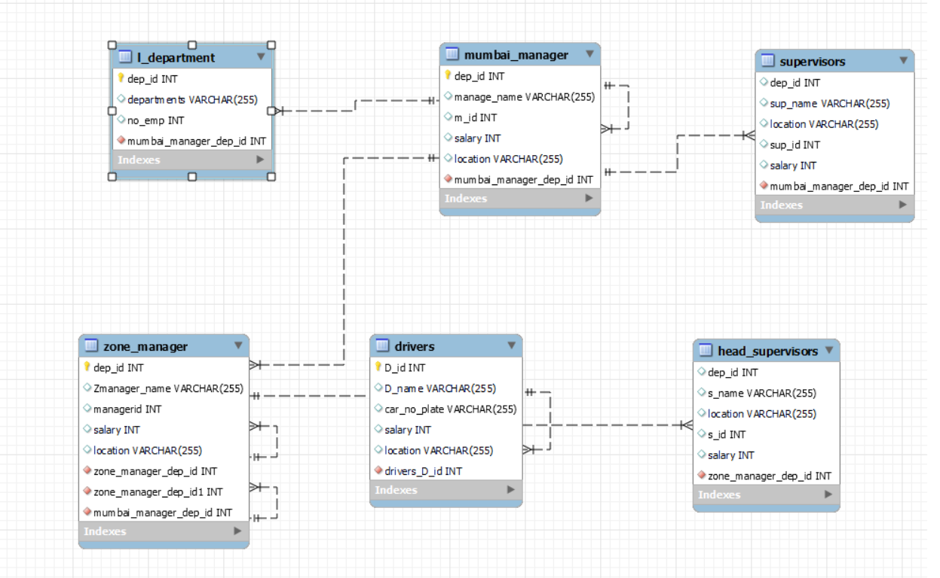
ER Diagram

Slide 5

Create Databases

Slide 6
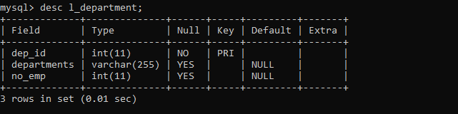
To Show structure of Table.

Slide 7

To Insert Records In Tables

Slide 8
Insert Query

Slide 9
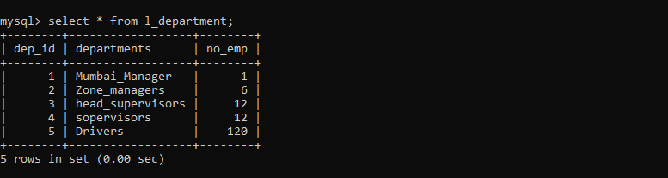
To see Table Records

Slide 10
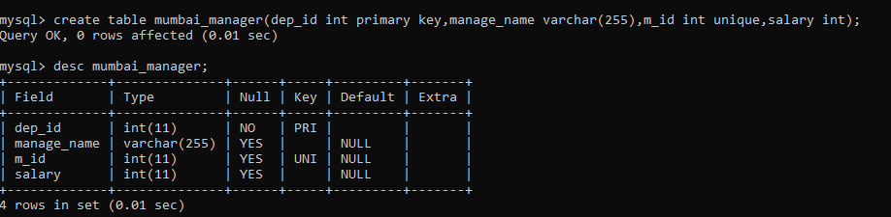
Create table & Describe Table

Slide 11

Insert Query

Slide 12
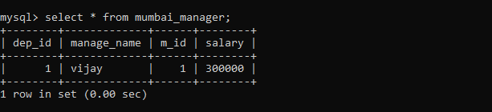
Select Query

Slide 13
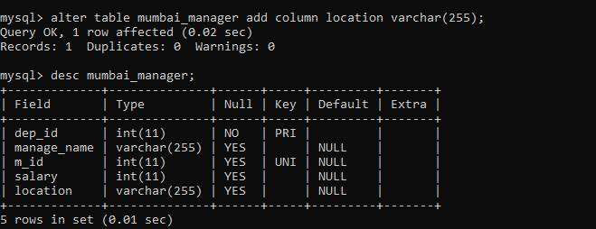
Alter Commands

Slide 14
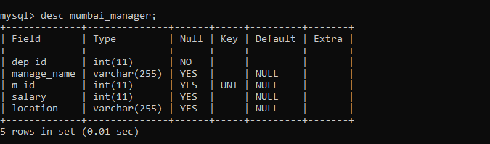
To Remove Primark Key & Describe Table

Slide 15
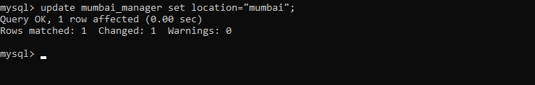
Update Command

Slide 16

To Reassign the Primary Key

Slide 17
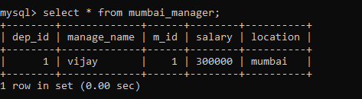
To Read the Table

Slide 18
To Create Structure of the Table & Inserting Records

Slide 19
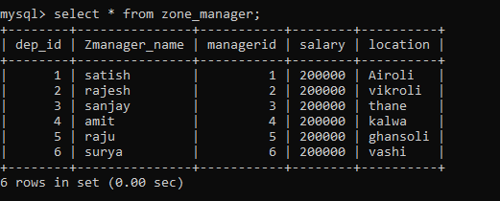
To Read the table

Slide 20
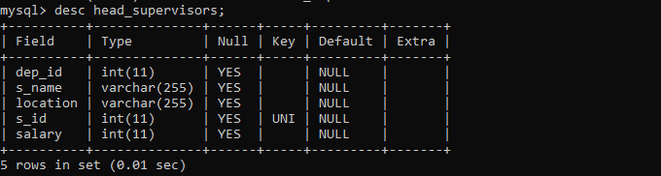
Create& Describing Table

Slide 21
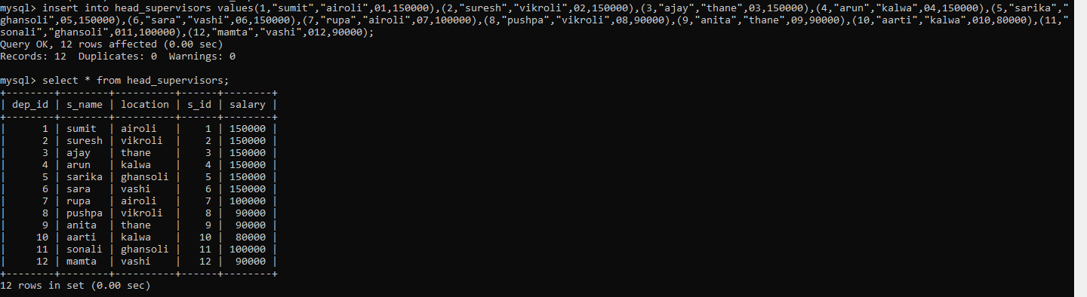
Inserting data & To Read the data

Slide 22
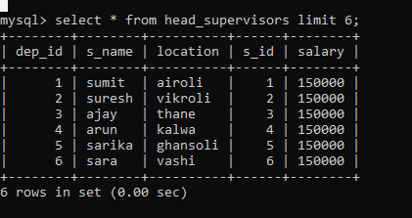
To Read data of table With Limit

Slide 23
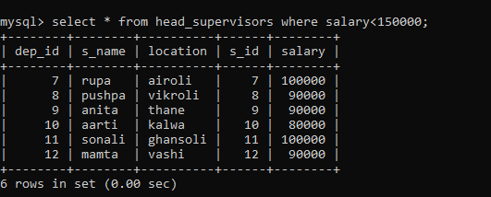
Where Clause with Comparison Operator

Slide 24
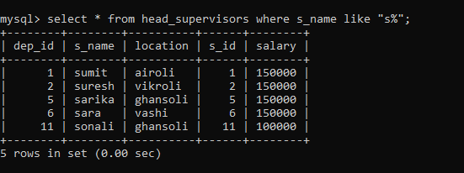
Where Clause with Like Operator

Slide 25
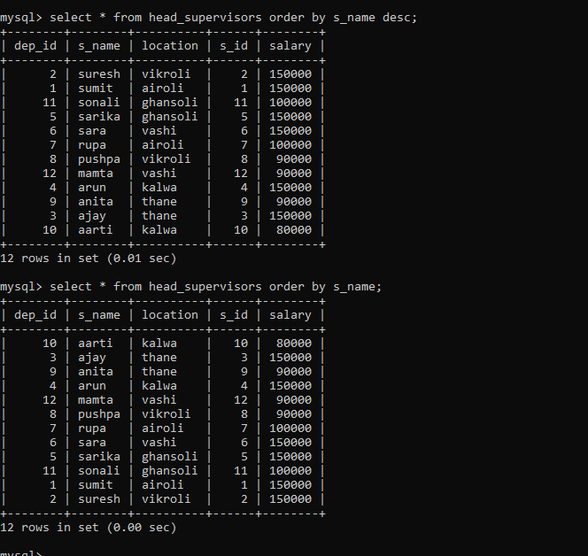
Order By Clause

Slide 26
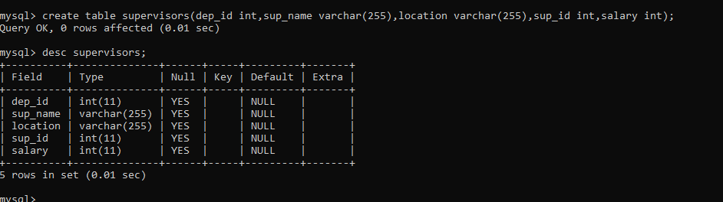
Create & Describe the Table

Slide 27
Insert Query

Slide 28
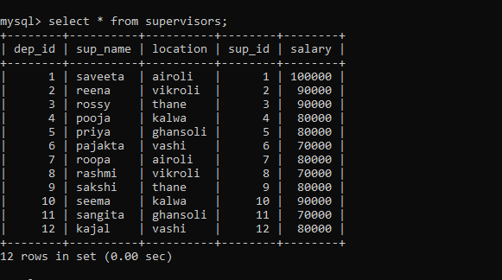
To Read Data

Slide 29
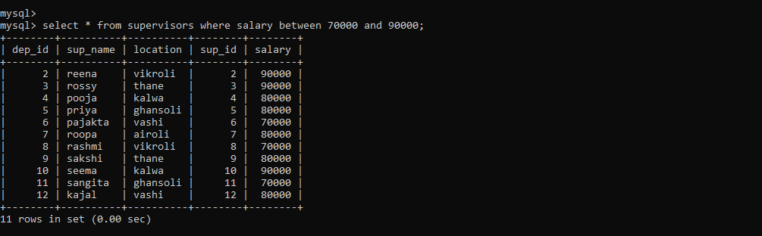
Where Clause with Between Operator

Slide 30
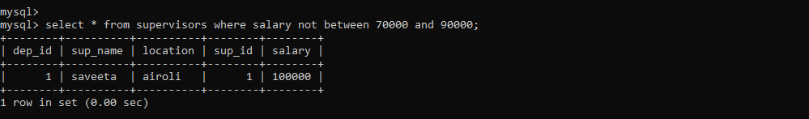
Where Clause with Not Between Operator

Slide 31
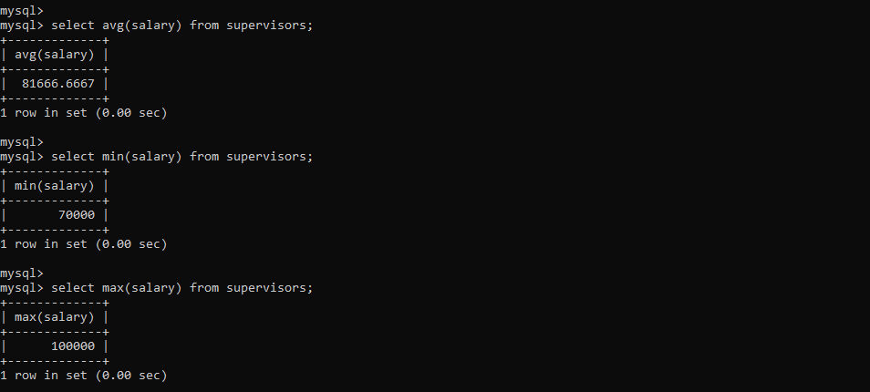
Aggregate Functions

Slide 32
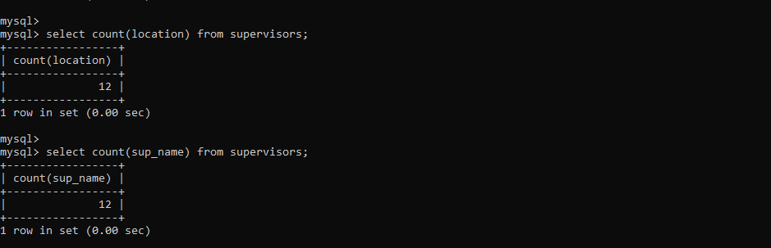
Aggregate Function

Slide 33
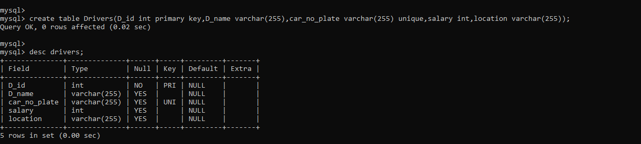
To create & Describe Table

Slide 34
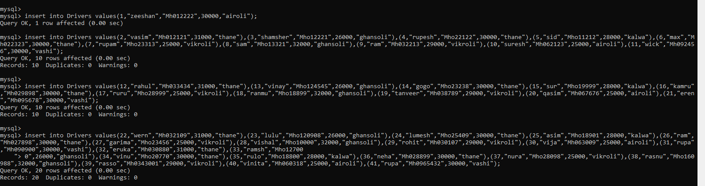
Insert Query

Slide 35
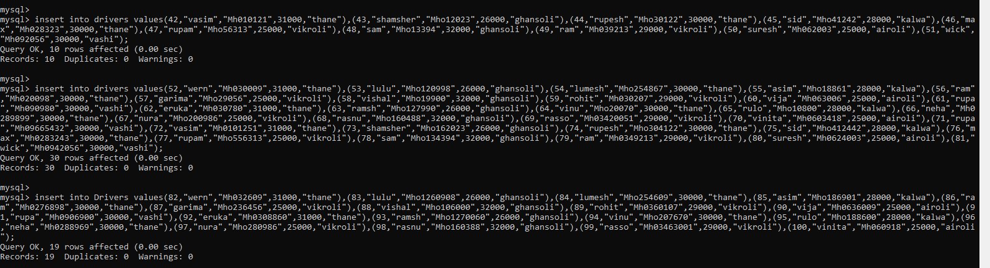
Insert Query

Slide 36
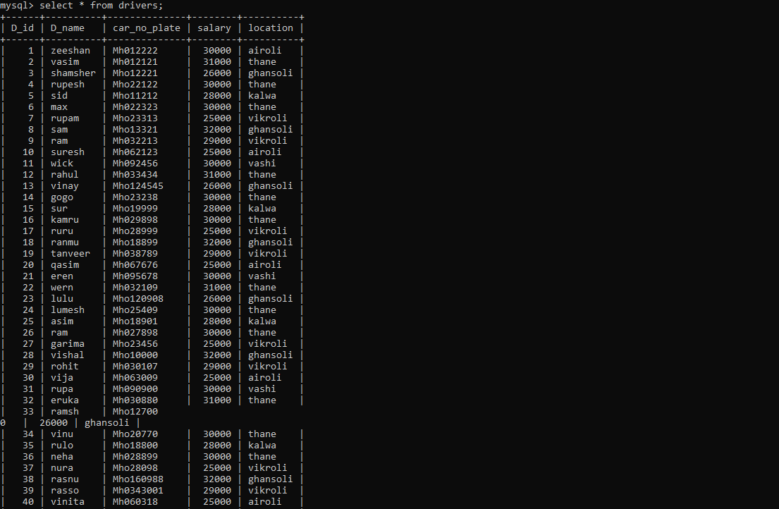
To Read the Data

Slide 37
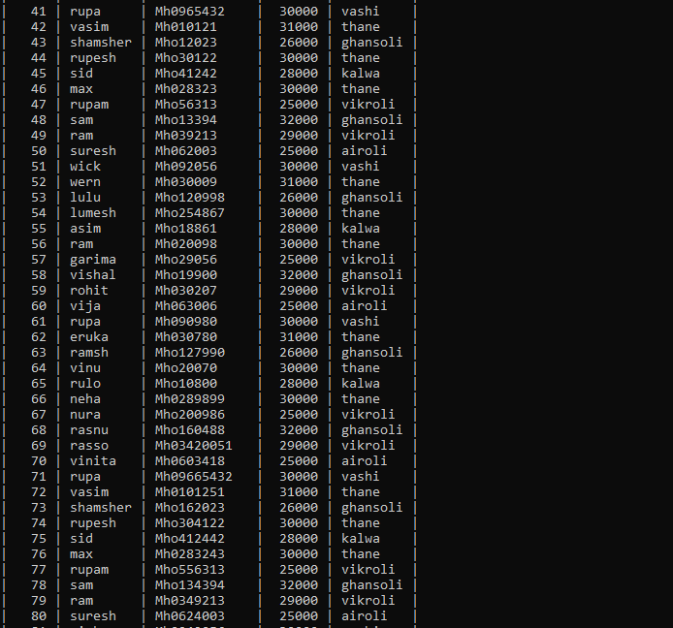

Slide 38
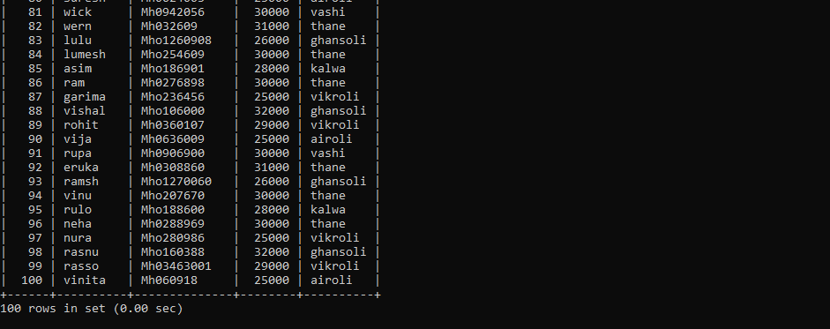

Slide 39
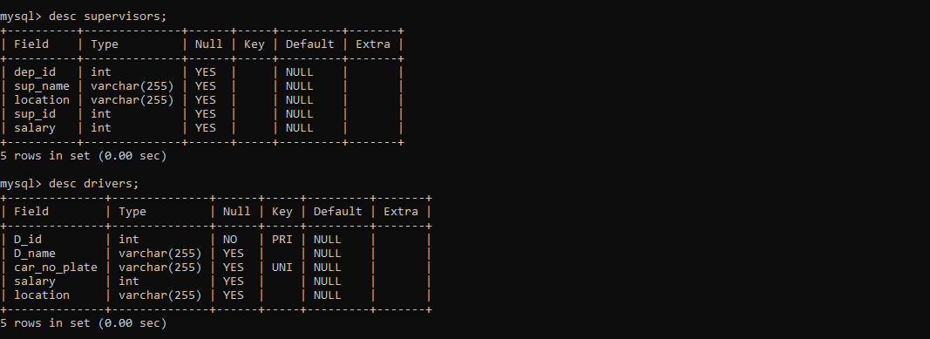
Describe Table

Slide 40
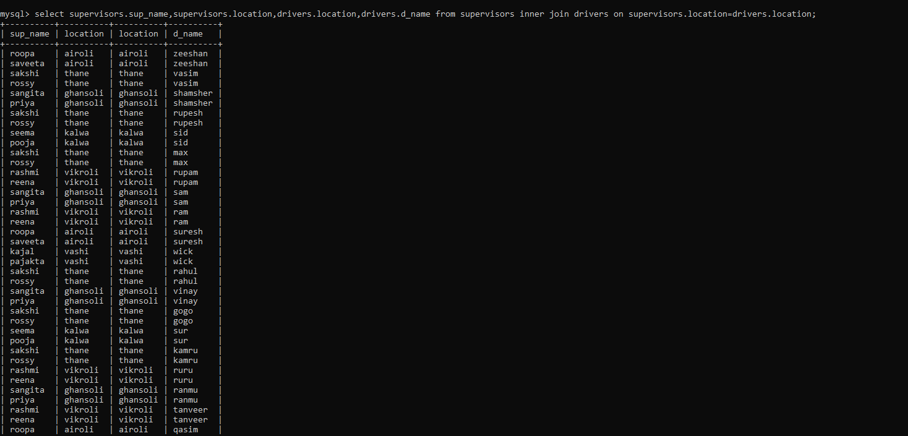
Join

Slide 41
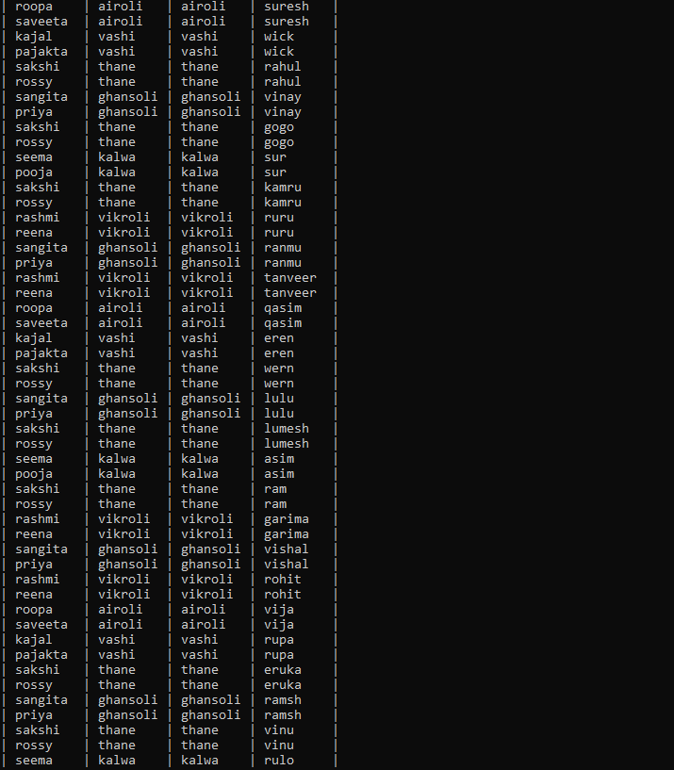

Slide 42
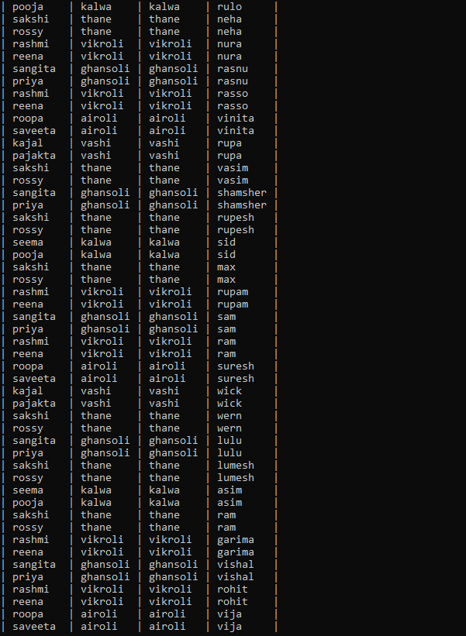

Slide 43
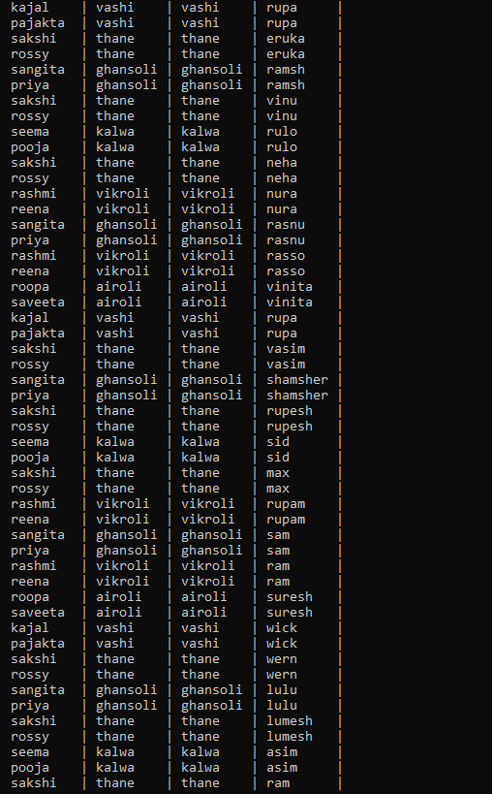

Slide 44
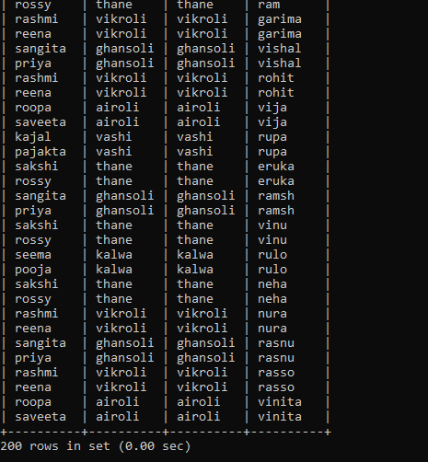

Slide 45
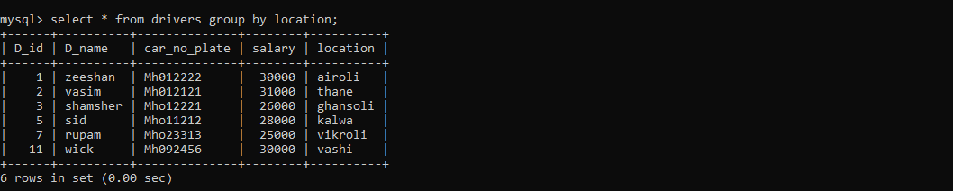
Group By Clause

Slide 46
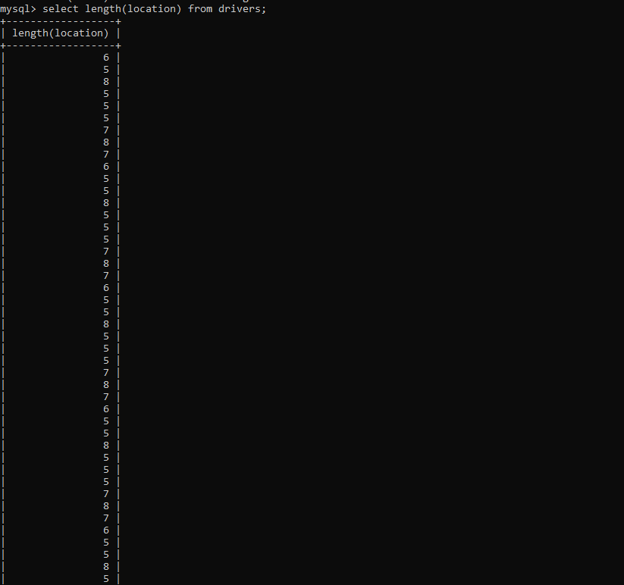
String Function

Slide 47


Slide 48
Thank You

